Slide 1
Unemployment in Sri Lanka

Slide 2
Introduction to Unemployment
Unemployment is a condition where a person actively searches for employment but is unable to find work.
Unemployment is considered to be a key measure of the health of the economy.
The most frequently used measure of unemployment is the unemployment rate.
(Unemployed ÷ Labor Force) x 100.

Slide 3
Unemployment in Sri Lanka
In Sri Lanka, the issue of unemployment is a significant concern affecting both the economy and the lives of its citizens.
As of the latest data available, Sri Lanka's overall unemployment rate stands at 5.2%.
This rate has fluctuated over the past decade due to various economic factors, such as global economic downturns and domestic challenges.

Slide 4
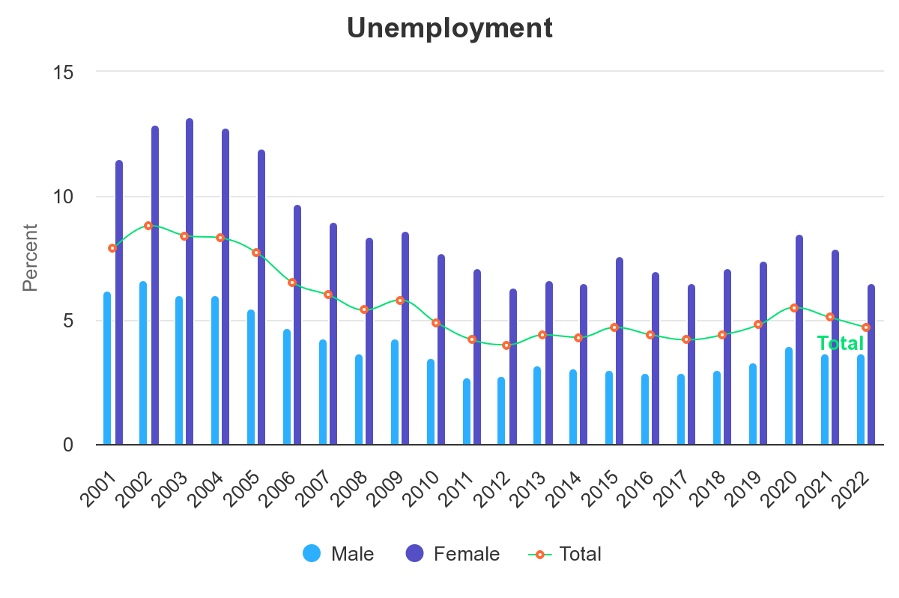
Unemployment Statistics in Sri Lanka

Slide 5
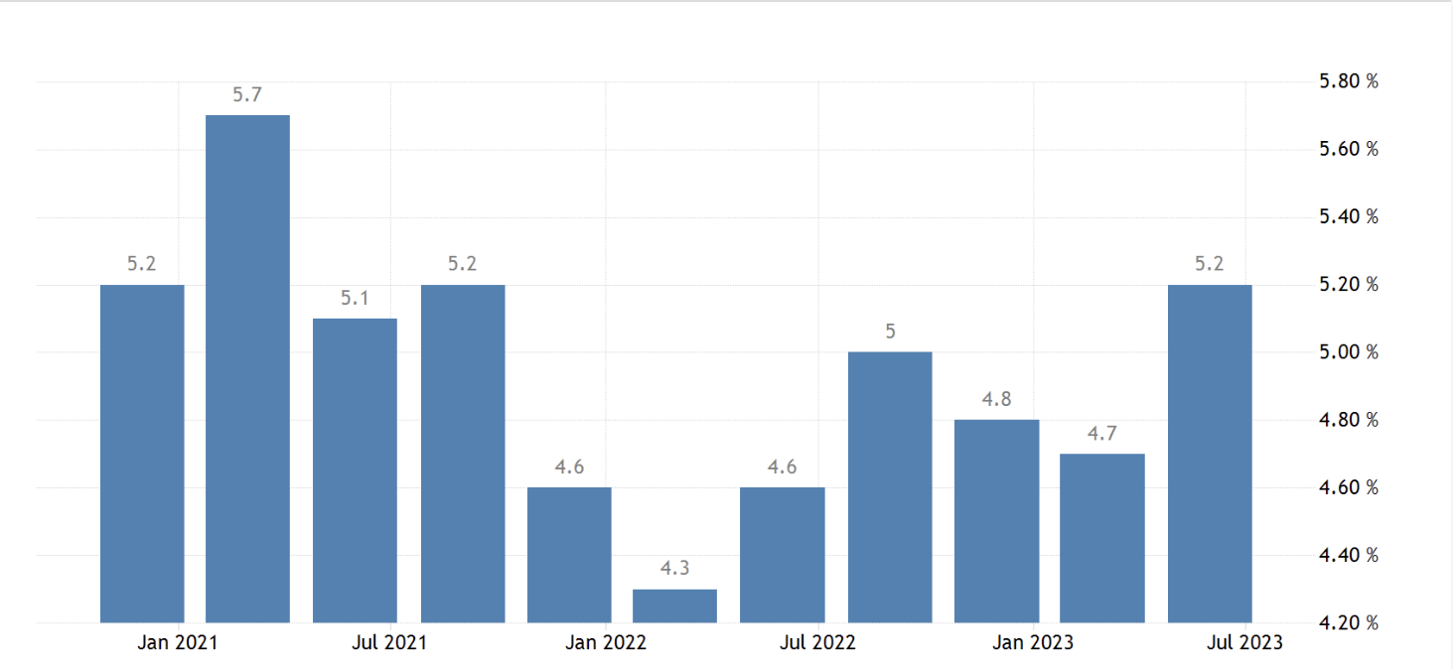
Unemployment Statistics in Sri Lanka

Slide 6
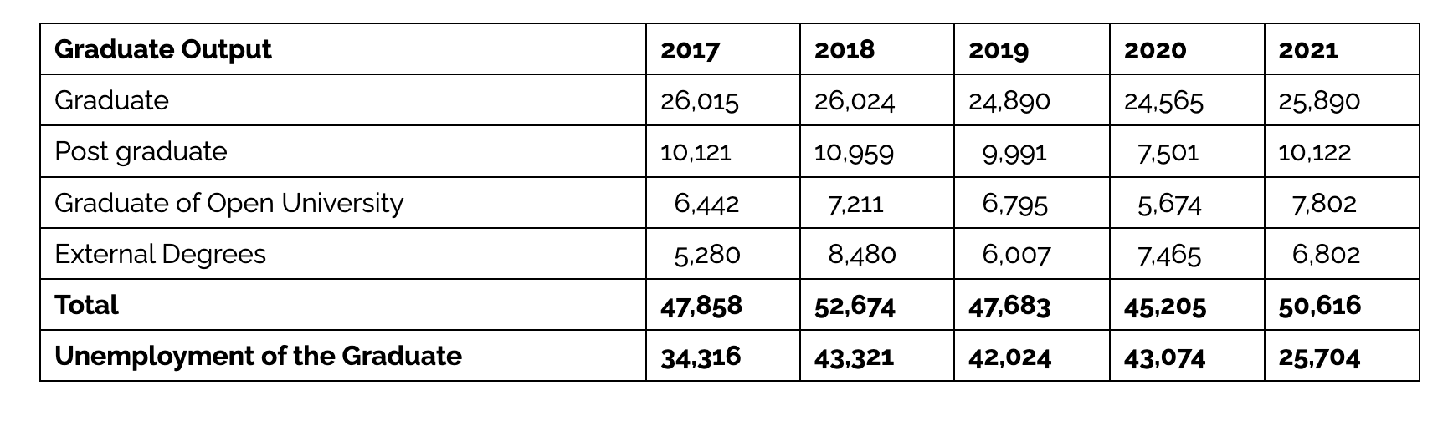
Graduate unemployment in Sri Lanka

Slide 7
Causes of Unemployment
Economic factors (e.g., lack of investment, economic downturns)
Educational system challenges
Wating in line
Technological advancements and automation
Lack of innovation
Demographic challenges (youth unemployment, gender disparities)
Government Policies

Slide 8
Economic factors
Economic stability and growth directly affect the employment rate of the economy.
During periods of economic recession, the economy has to shrink its business operations, and this will lead to an increase in the unemployment rate in the economy.
A cut in public spending is a requirement for an IMF bailout

Slide 9
Educational system challenges
Challenges within the educational system, such as a mismatch between skills taught and those demanded by the job market
Many private sector businessmen have identified the weakness of Sri Lanka’s higher education system as the reason for this mismatch.
They complain that the content and quality of education available to inculcate modern skills, aptitudes and job orientation in the workforce is poor.

Slide 10

Waiting in line
Sri Lankans prefer a government job to a private sector job because of job security and post-retirement benefits.
Thus, even if they get jobs in the private sector, people are waiting for government jobs.

Slide 11
Lack of innovation
Research and development is a key factor in economic growth and development.
The prescribed rate for research and development for a developing country is 1% of the country’s gross domestic product.
In Sri Lanka the ratio is only approximately 0.1% and this too is mainly related to the public sector.
As a result, business expansion is very limited, resulting in less job creation

Slide 12

Effects of Unemployment
Economic consequences - economic strains, widening the gap between the rich and the poor
Social implications (poverty, inequality)
Psychological effects on individuals and families

Slide 13
Government Initiatives and Policies
Training and skill development initiatives
Job creation strategies and employment schemes
Encouragements on foreign employment
Free Trade Zones

Slide 14
Solutions and Recommendations
Education reform and skill development programs
Encouraging entrepreneurship and small business development
Enhancing labour market flexibility and opportunities
Collaboration between public and private sectors

Slide 15
Case Studies or Success Stories
It's your work....
Identify a success story where individuals or communities have benefited from government programs or private initiatives
showcasing the positive impacts of these employment initiatives.

Slide 16
Future Outlook
Predictions for the future of unemployment in Sri Lanka
Challenges that need to be addressed - demographic shifts, technological advancements, and economic changes.
Strategies need to be adaptive and forward-thinking to counter these challenges effectively.
Potential opportunities for improvement

